Slide 1
Determining a Restaurant Location
Applied Data Science Capstone
Nakisha Boulware Watts, PhD, MBA/MHA

Slide 2
Situation
North York is the fastest growing cities in Toronto, Ontario, Canada
North York is a cross-section of inhabitants which includes students and long-time residents, giving the city an eclectic feeling of being both local and international.
According to the North York City 2016 Census of Toronto Community Council Area Profiles, this multicultural and multiracial city has a population of 691,595 with a population growth of eight percent.

Slide 3
North York Rise and Grind
North York Rise and Grind will appeal to the millennial customer of North York’s eclectic vibe, with the following location criteria.
Bakery
Boutiques
Coffee Shops
Cafe

Slide 4
Data Sources
Canada census data for 2011 and 2016 by providence, territory, city and neighborhood was acquired from Statistics Canada
Canada neighborhood postal codes were obtained from Wikipedia
Geospatial coordinates were acquired from the Coursera Capstone Course
Venue data from Foursquare

Slide 5
Data Cleaning
Canada census data for 2011 and 2016
Id
neighborhood
characteristic (census question)
Canada neighborhood postal codes
Postal code
borough
neighborhood
Geospatial coordinates
postal code
latitude
longitude

Slide 6
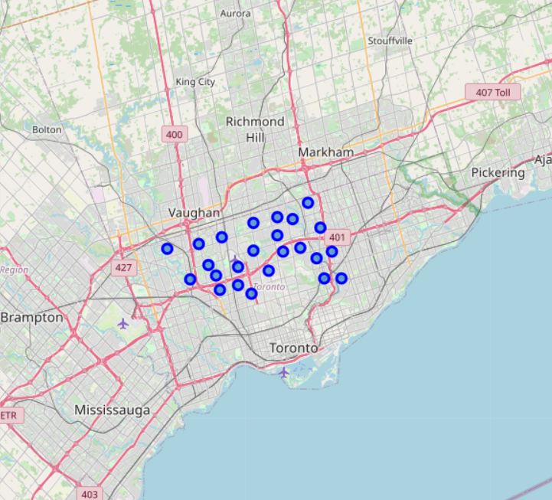
North York Neighborhoods

Slide 7
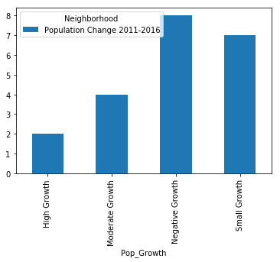
North York Neighborhood Population Change

Slide 8
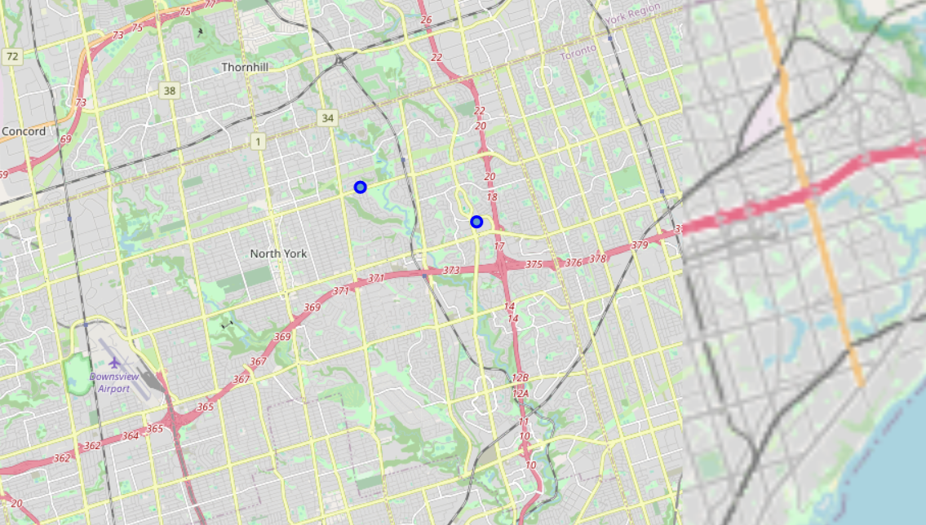
Most Likely Neighborhoods

Slide 9
Venues

Slide 10
Fairview, Henry Farm, Orieole Venues

Slide 11
Fairview, Henry Farm, Orieole

Slide 12
Conclusion
Venue clustering was used to determined that Henry Farm is the best location to open the restaurant given its increase in population growth and venue categories, as well as the little to no competition.

